Slide 1
GitHub to Start
SESSION 1
UTM KUALA LUMPUR

Slide 2
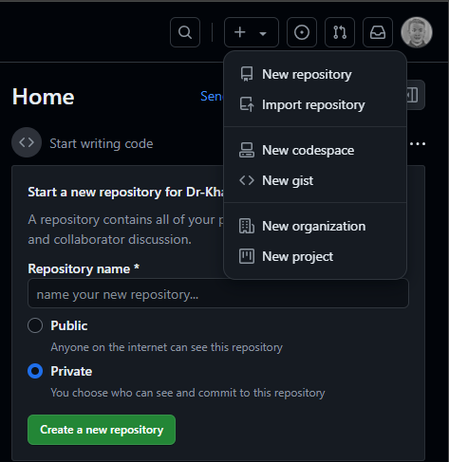
Setup a Repository
Sign in to GitHub:
  Go to GitHub and sign in to your account.
Create a New Repository:
  Click on the + icon in the top right corner and select New repository.
  Fill in the repository name, description (optional), choose visibility (Public/Private), and select options like initializing with a README file.
  Click Create repository.

Slide 3
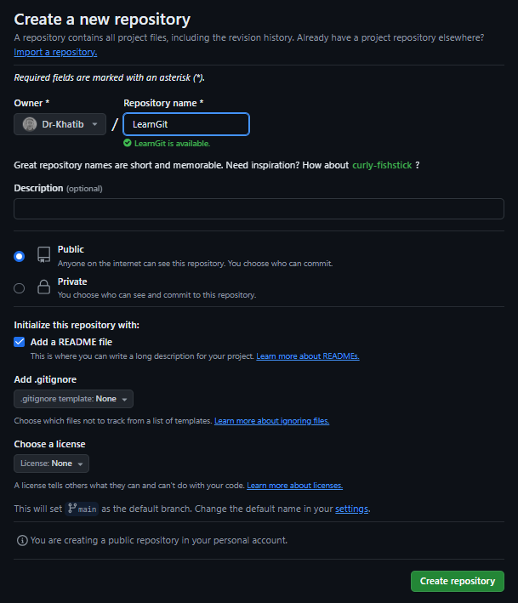
Setup a Repository
Repo name with no spacing
Repo type
Preferable to initialize with README file
Done creating repo

Slide 4
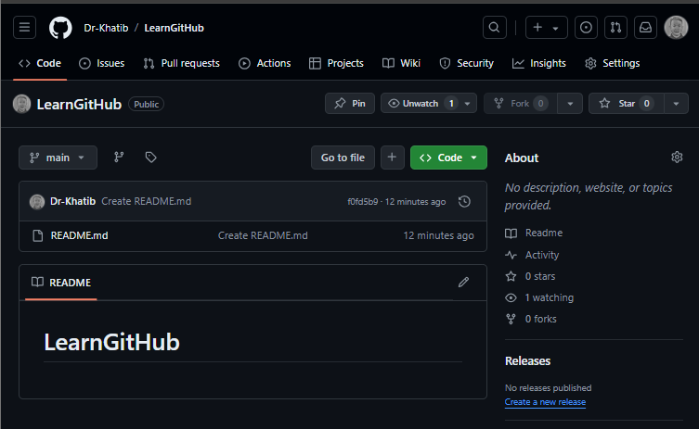

Adding Contributors (OPTIONAL)
Go to Repository Settings:
  Navigate to your repository on GitHub.
  Click on the Settings tab.
Manage Access:
  In the left sidebar, click on Collaborators & teams.
  Click Add people.
  Enter the GitHub username or email of the person you want to add.
  Select their role (e.g., Write, Admin) and click Add.

Slide 5
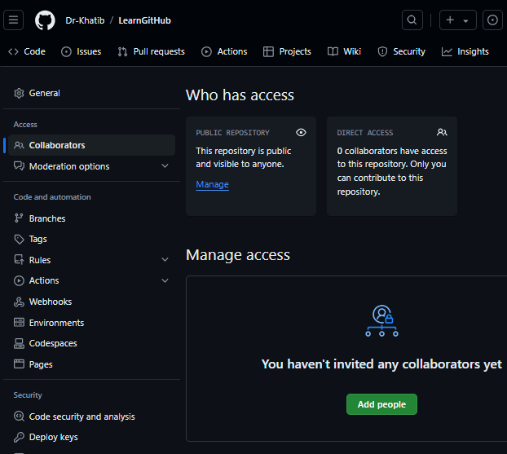
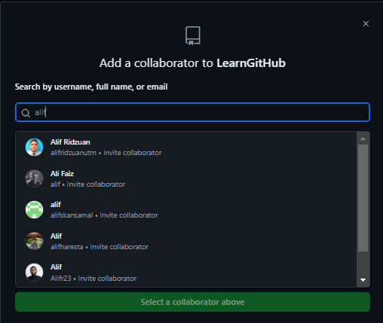
Adding Contributors (OPTIONAL)
Preferable to follow the person to get better suggested list of user. There are a lot of almost similar names.
The contributor must accept within certain period (days).

Slide 6
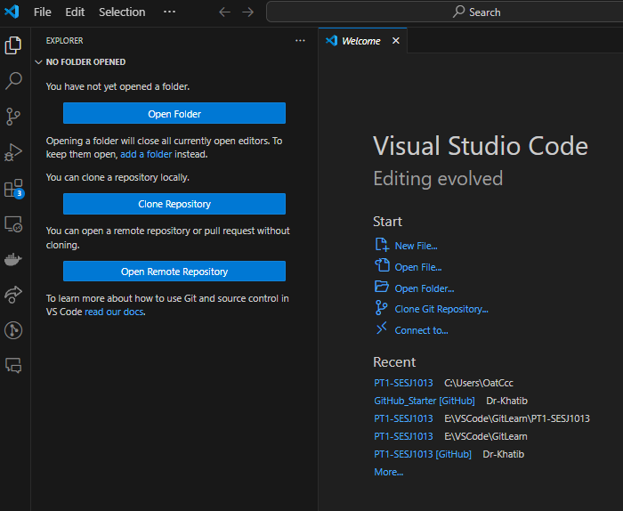
Clone to Local using VSCode
VS Code has built-in Git support, which makes it easy to manage repositories. Here’s how you can clone a repository using VS Code:
1. Open VS Code
- Launch Visual Studio Code on your machine.
2. Open the Command Palette
- Press Ctrl + Shift + P (Windows/Linux)
- Cmd + Shift + P (Mac)
3. Clone a Repository
- type Git: Clone in the Command Palette and select it from the list.
- Choose the directory where you want to clone the repository.
- VS Code will clone the repository and open it in a new window.

Slide 7
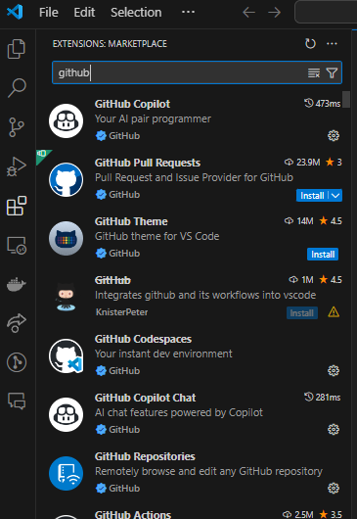
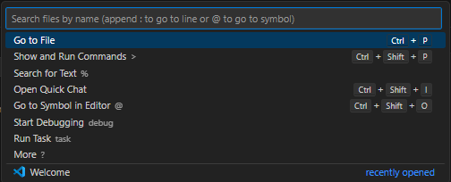



Clone to Local using VSCode
Ctrl + Shift + P
Recommended
Extension
Git : Clone
Clone from GitHub
Pick your repo
Recommended
Extension
Then set where to clone your repo in your local machine

Slide 8
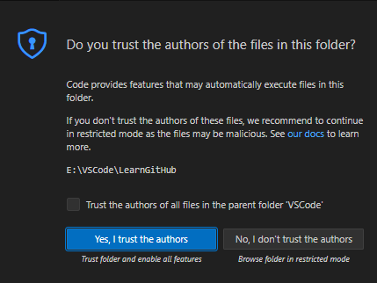
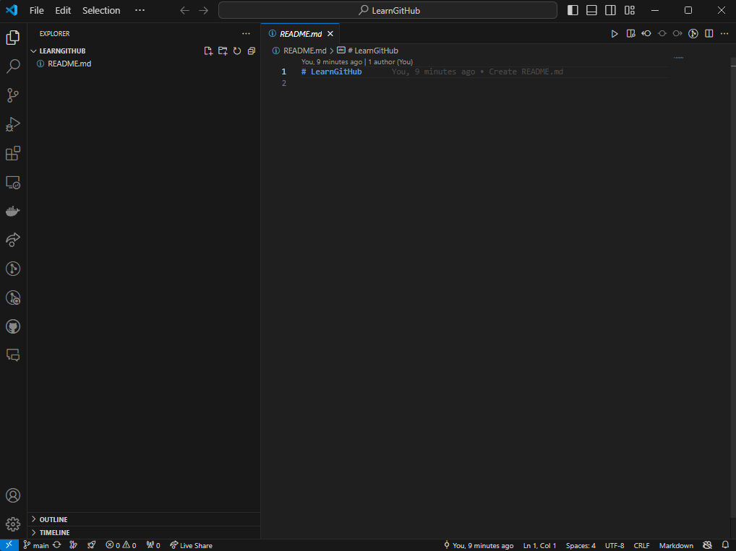

Clone to Local using VSCode
Trust issues? Trust nobody, including yourself.

Slide 9
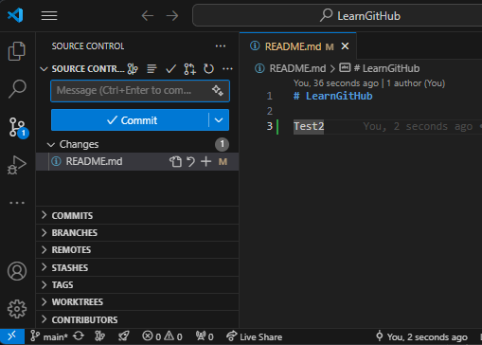
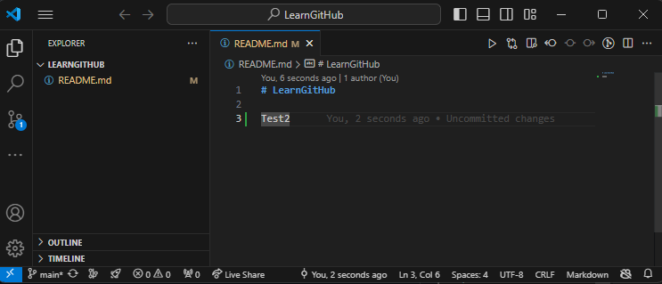
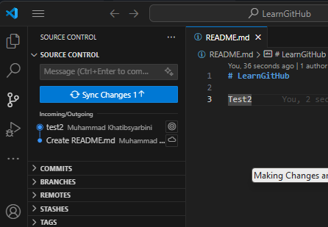
Making Changes and Commit using VSCode
3. MUST Write any message before commit
2. Then press source control
1. Make any changes
4. Press Sync Changes button..
Sync message is optional..

Slide 10
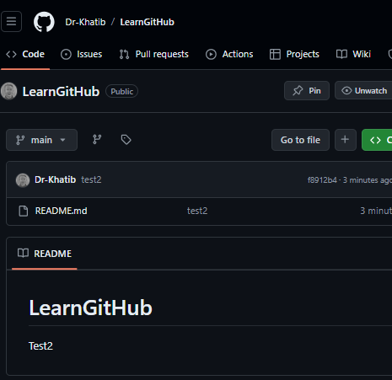
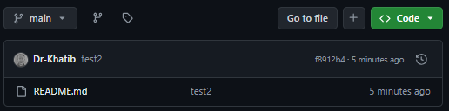
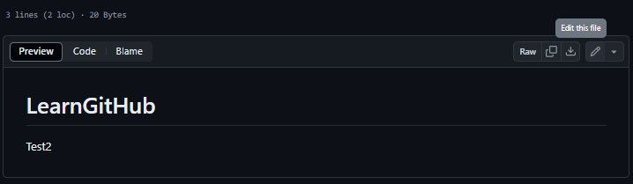
Making Changes and Commit using VSCode
1. Click the file
2. Click edit file
The commit message
Changes updated

Slide 11
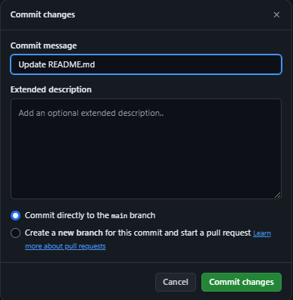
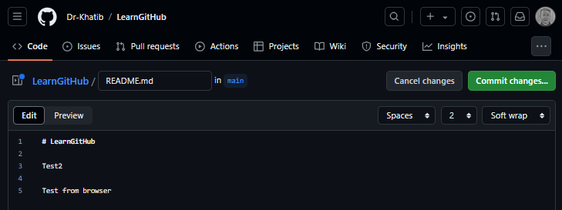
Making Changes and Commit using VSCode
2. Commit changes
3. Commit changes
1. Make any changes

Slide 12
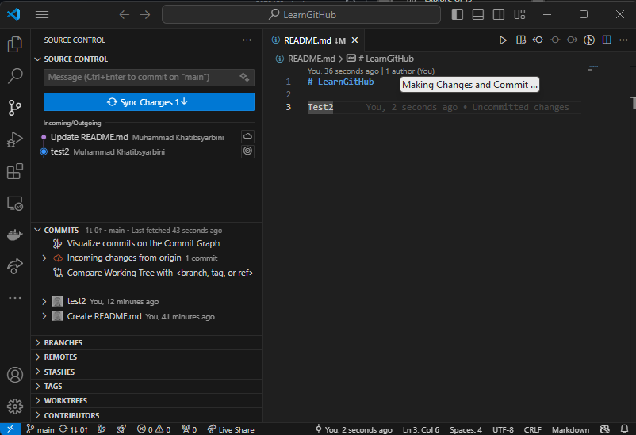
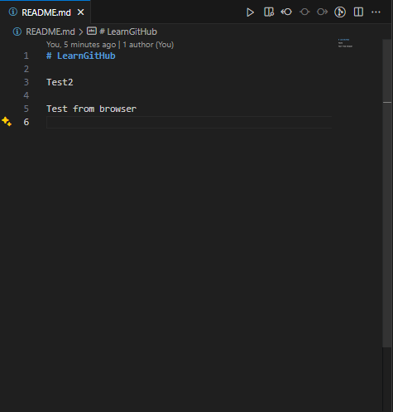
Making Changes and Commit using VSCode
Click sync if want direct updates
In source control VSCode auto detect changes
Updated
Or can read the incoming changes here

Slide 13
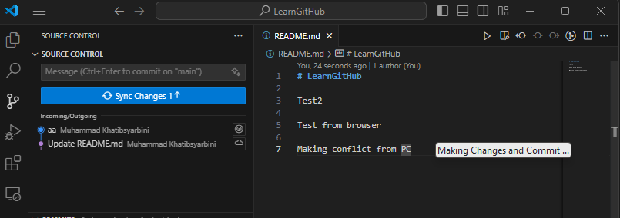
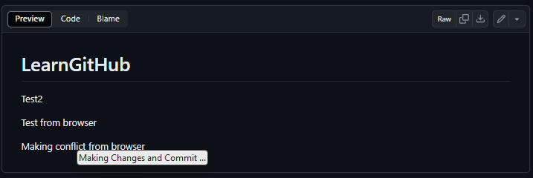
Making Conflict and Resolve
Make changes in vscode and then commit. Don’t sync first
Then make a changes in browser. Commit

Slide 14
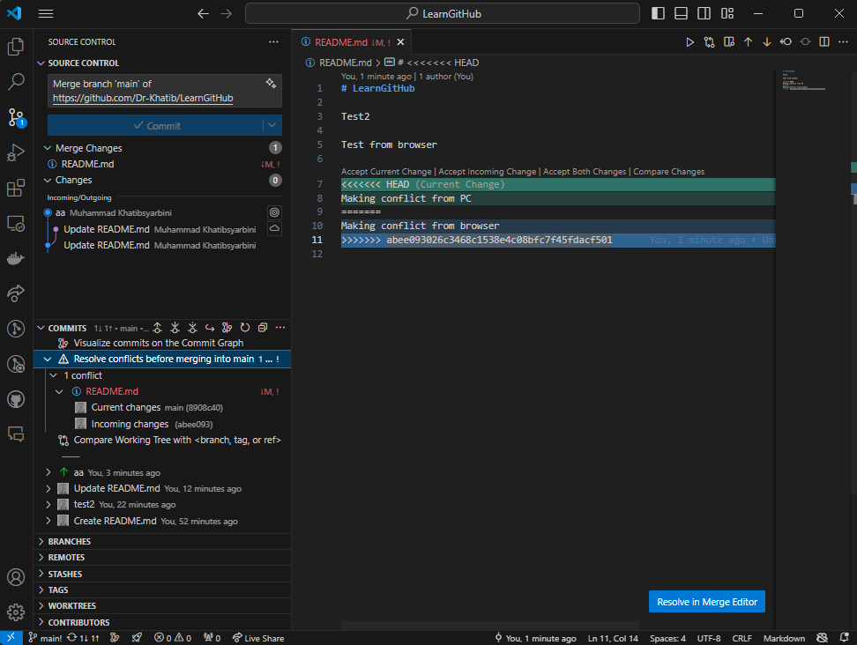
Making Conflict and Resolve
Try to sync you will get this
Resolve in Merge Editor

Slide 15
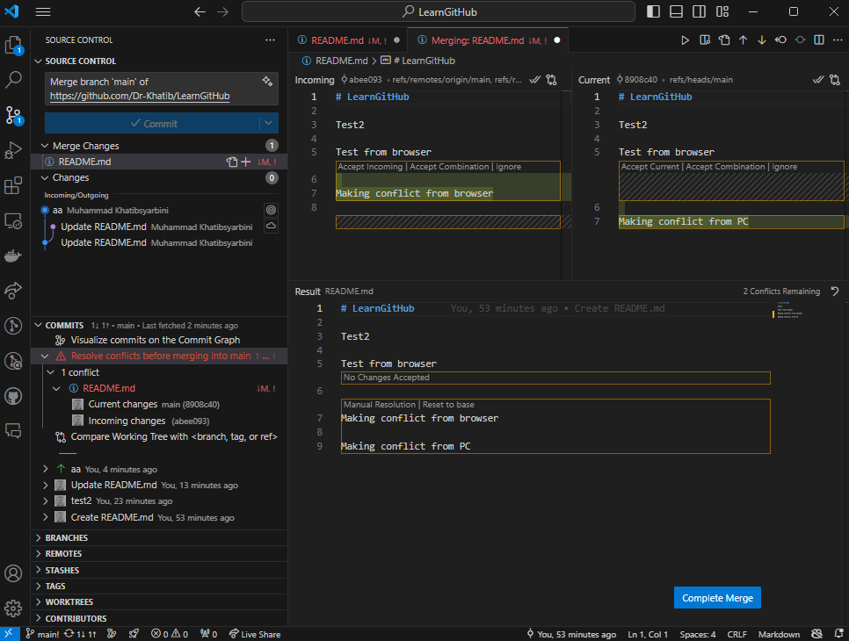
Making Conflict and Resolve
Once completed
Can accept or combine or ignore
Once completed press here then commit and sync at source control

Slide 16
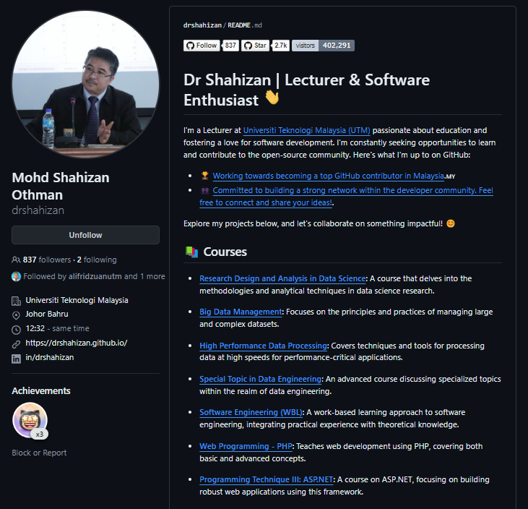
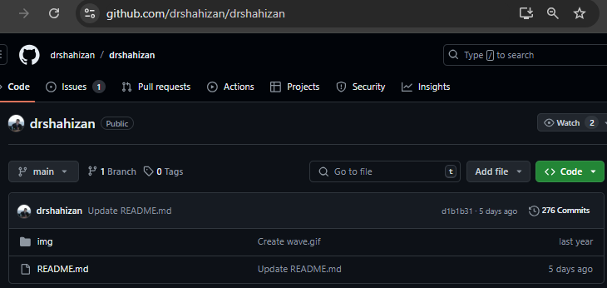
Exercise: Create GitHub Profile
Create a new repo.
Name the repo exactly like your username
Edit the README.md file as your profile
TIPS : Any folder added within repo, preferable to have README.md file inside each folder

Slide 17
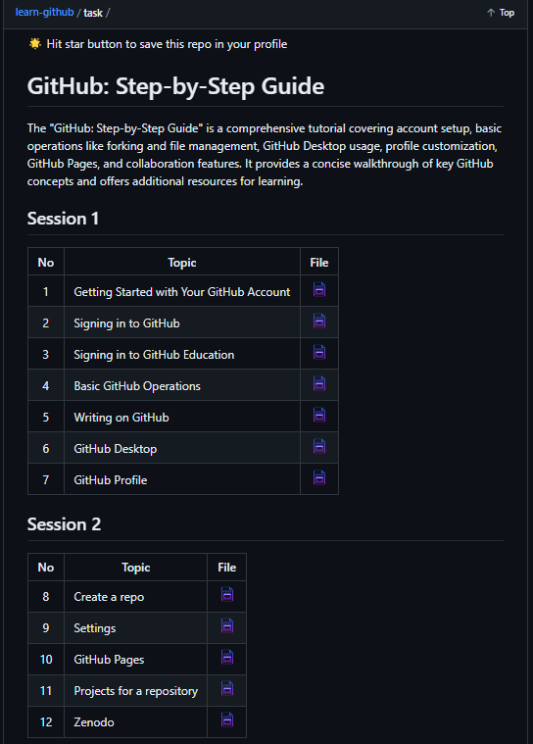
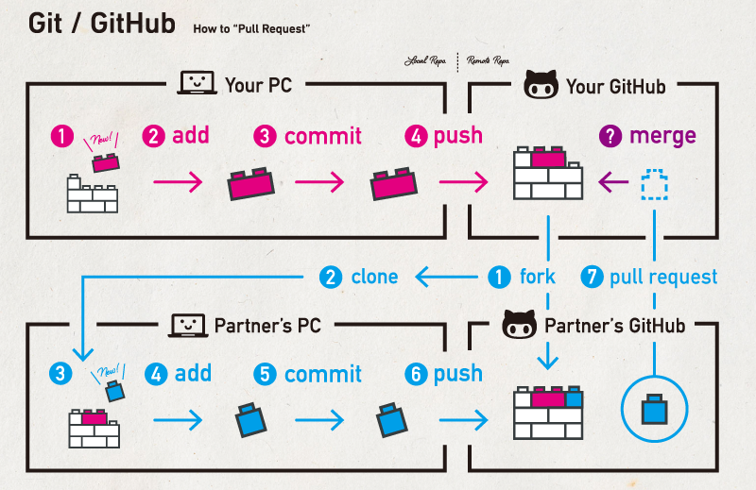
For More Extra References.. Visit Dr Shahizan GitHub
https://github.com/drshahizan/learn-github
https://github.com/drshahizan/learn-github/tree/main/task

Slide 18

THANK YOU
In the Name of God for Mankind
univteknologimalaysia
utm.my
utmofficial

